Slide 1

Optimized Tactical Routing for Unmanned Ground Vehicles
CDT Jacob Hyatt
Advisor: LTC Grymes

Slide 2
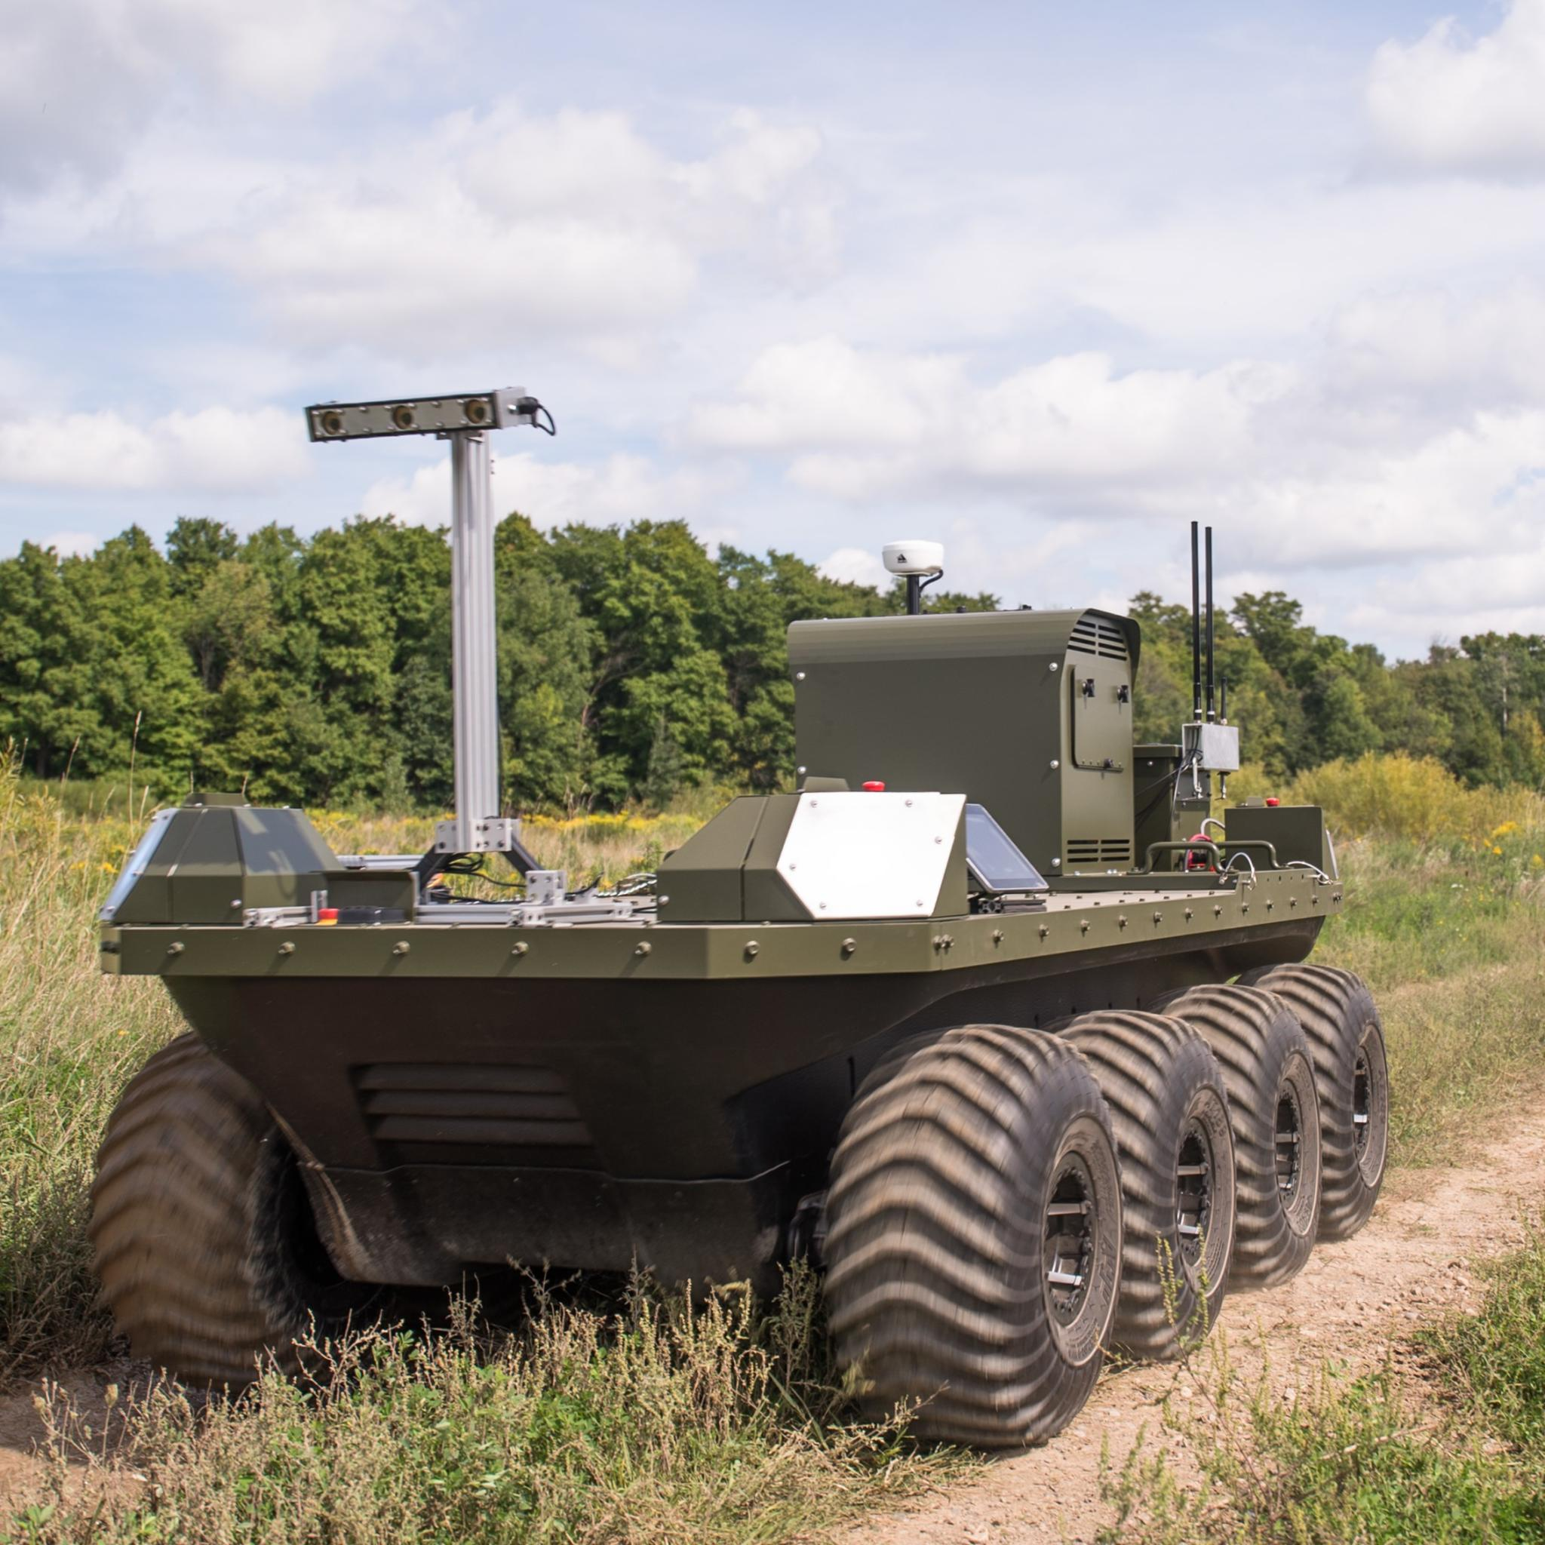
Scope
What is the optimal path for an unmanned ground vehicle in a contested environment?

Slide 3
Previous Work
Do I put my work with humans?
Very little robot wise…

Slide 4
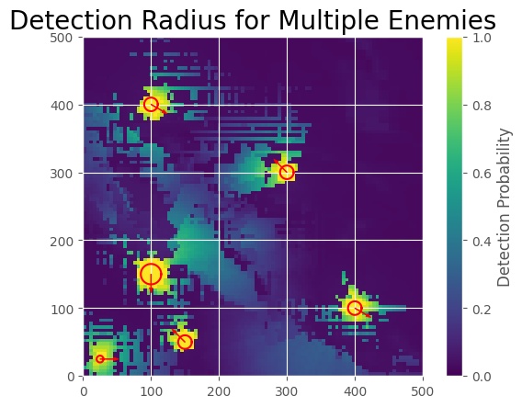
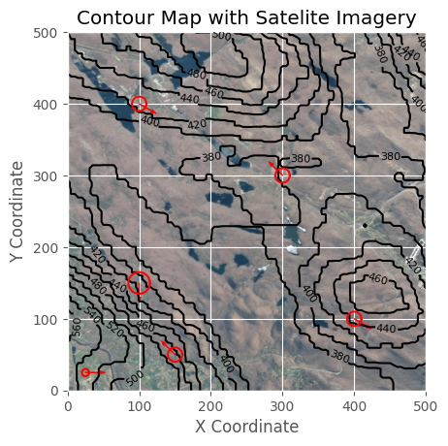
Methods
Overlay a 2-D node network over satellite imagery
Calculate detection and energy cost values for edges between all nodes
Run Gurobi Optimizer program
Plot outputted path

Slide 5
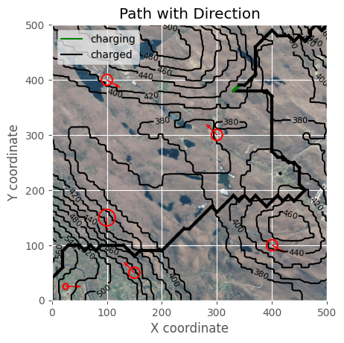
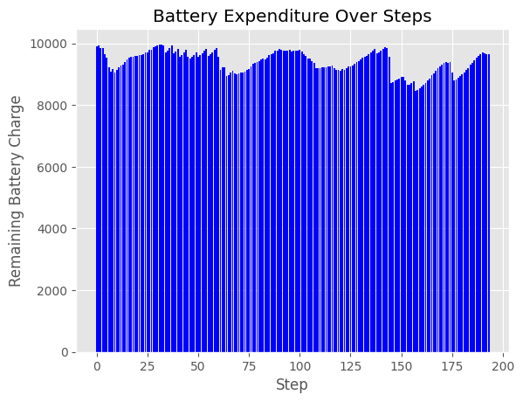
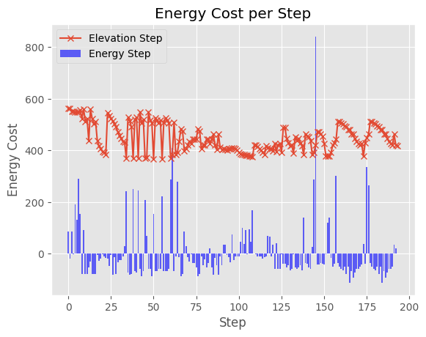
Even Weight

Slide 6
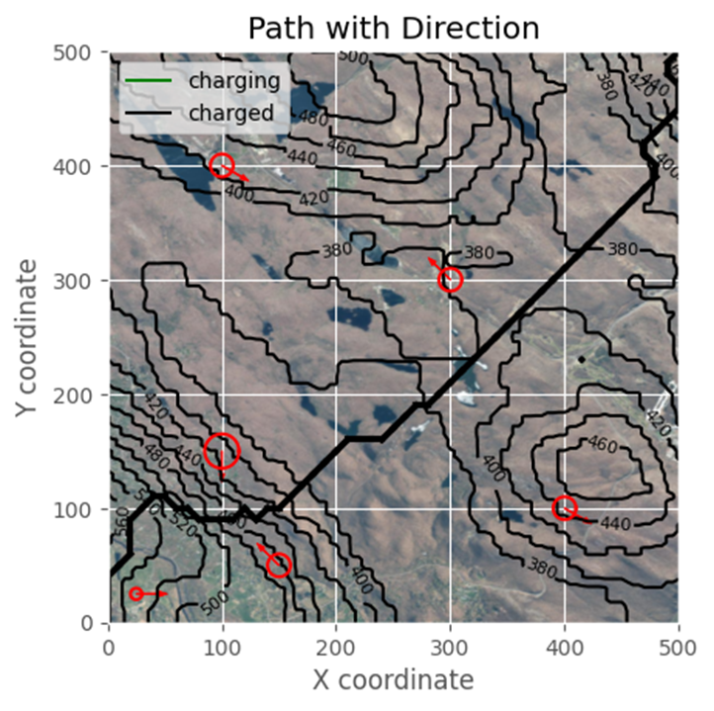
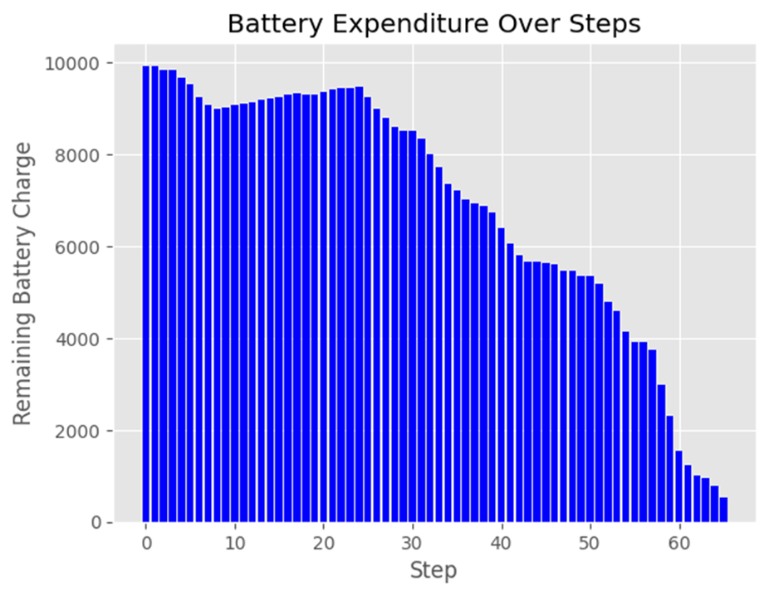
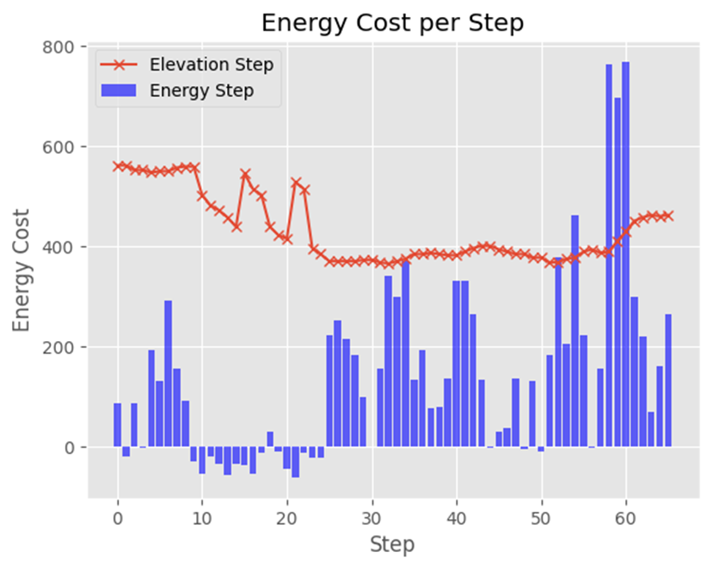
Detection

Slide 7
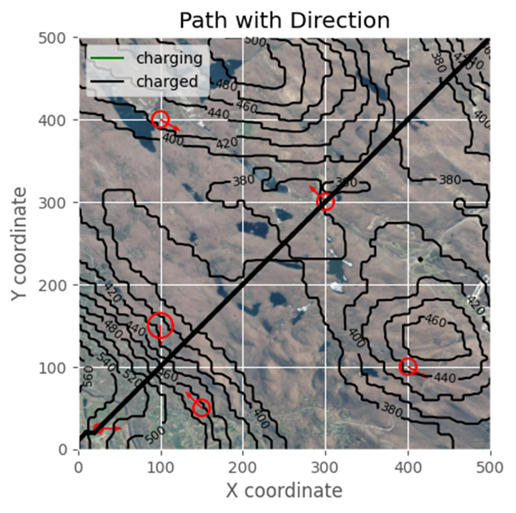
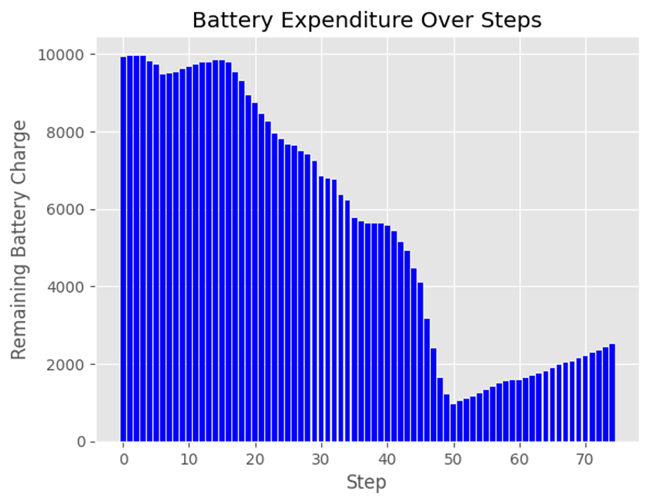
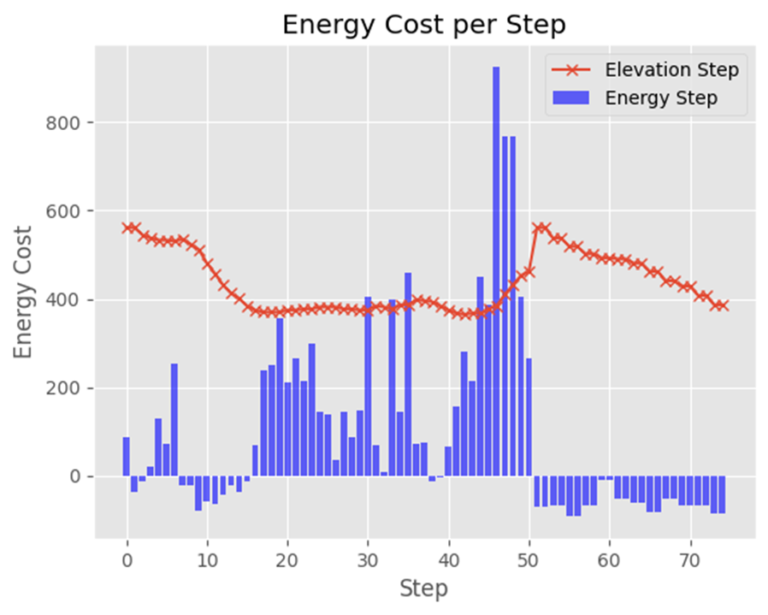
Battery Charge

Slide 8
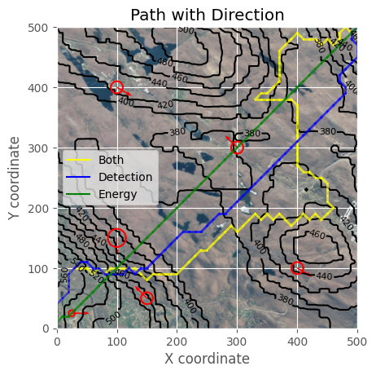
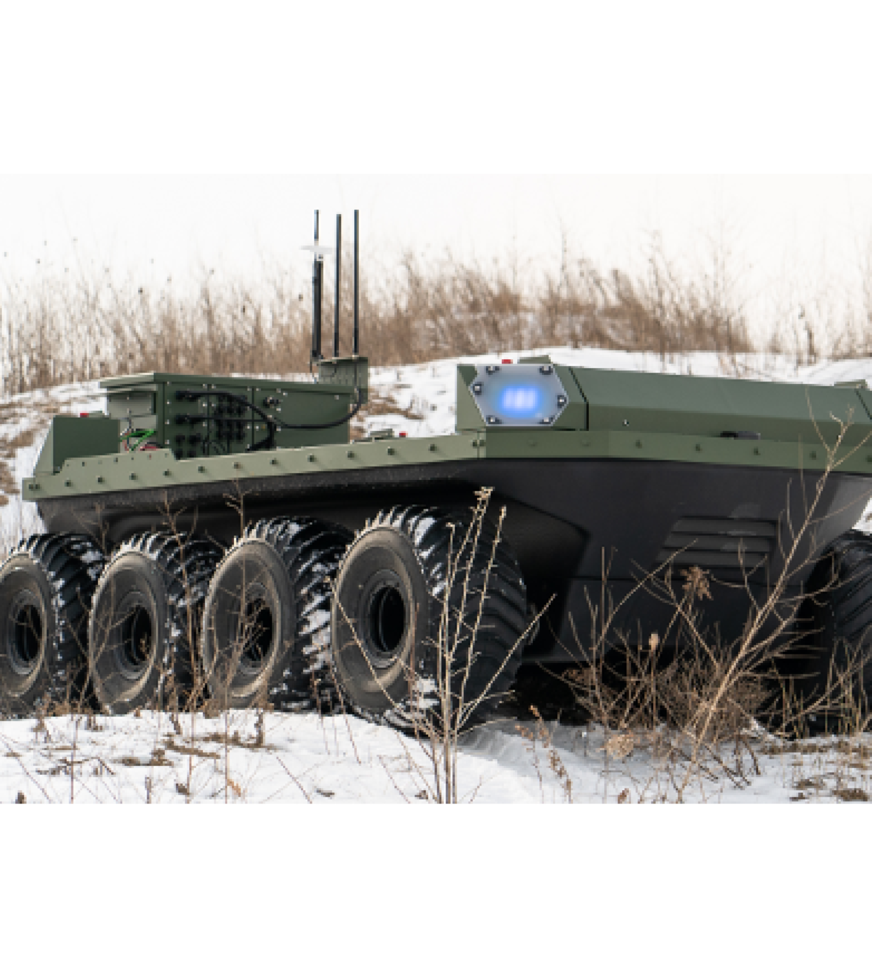
Future Work
Explore Further Automation of Pareto Frontier
Write Paper

